Slide 1
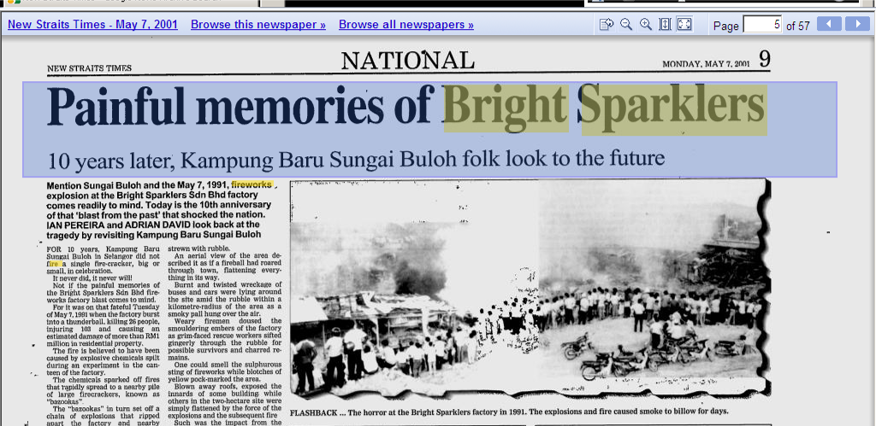
Occupational Safety & Health Act (OSHA 1994)
*Any safety and health issues relevant with our occupation / work place.
7th May 1991

Slide 2
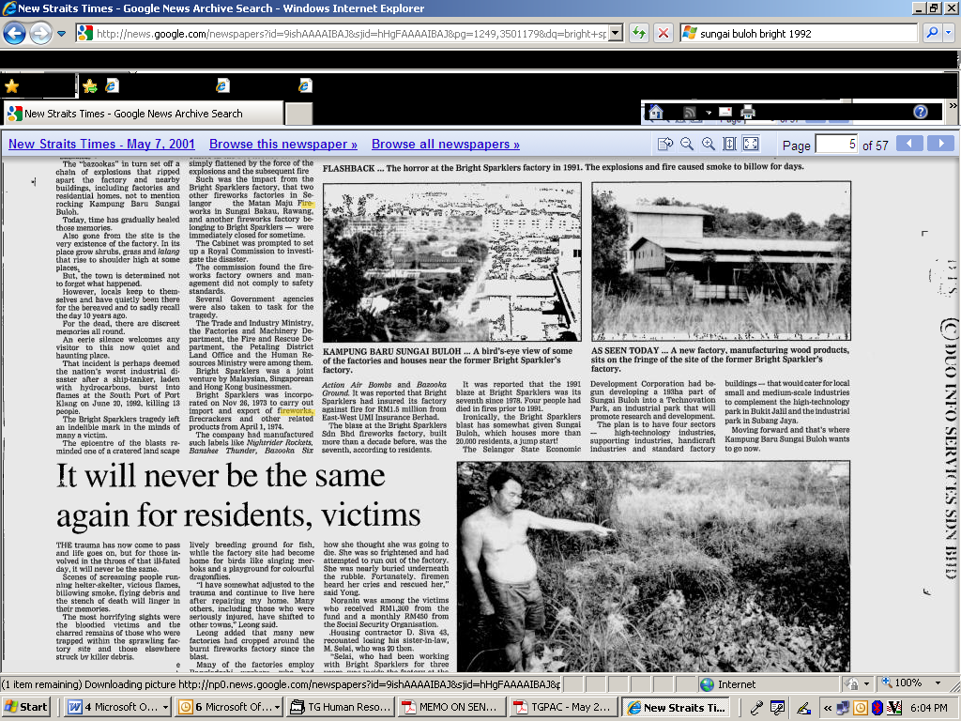

Slide 3
Examples of hazard at our workplace:
(1) Fire / emergency evacuation (OS)
(2) Fire / Fire extinguisher handling (OS)
(3) Hazard at production line: Wearing Personal
Protective Equipment (PPE) upon entering the
production factory (OS)
(4) Ergonomics (OH)
(5) Inhaling of excessive hazardous chemical (OH)
(6) Noise hazard (OH)

Slide 4
(1) Fire / Emergency Evacuation
Situation:
Upon hearing the fire alarm, leave the office / factory to take a look around.
If you see fire, smoke or smell something burning (Immediately activate the fire alarm if it is not activated yet), to alert others :
Steps:
(i) shout ‘fire, fire, fire’, put out the fire if you know how to handle a fire extinguisher while the fire is controllable/small.
(ii) evacuate the building through emergency exits to the designated assemble point outside the building.
(iii) do not run but walk quickly to avoid injury/fatality and delay in the evacuation process.
do not use lift but staircase (we may be trapped in lift due to current cut off, smoke and heat may enter the lift and kill).
Call the nearest BOMBA directly in order to save time, to call 999/112 only if the number is not available.

Slide 5
(2) Fire Extinguisher Handling
PASS
P = pull out the safety pin
A = aim at the base of the fire
S = spray by pressing the handle
S = sweep left and right or forth and back

Slide 6
(3) Wearing PPE upon entering production factory
Safety helmet (white for office staff and engineers, orange for maintenance, blue for supervisors, yellow for workers, red for safety personnel)
Safety shoes
Mask
Earplug
Hair net / cap
Remember: PPE is the least effective way to protect our safety and health after Elimination, Substitution, Isolation, Engineering Control, Administrative Control

Slide 7
(4) Ergonomics
Ergonomics is the study of designing equipment and devices that fit the human body and its movements.
(1)How we lift loads (i.e. carrying files, boxes) ?
Place feet apart, bend your knees not your back, keep the back straight, carry out the lifting motion smoothly.
(2)How we sit ? Click on link:
Foot flat on floor, adjust the chair’s height so that our arm remain 90 degree on the table, sit straight, etc.
(3)How we walk ?
The higher your chin is, the straighter your back will be.

Slide 8
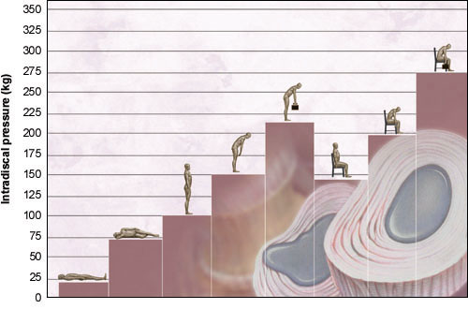
Relationship between Posture and Pressure on the Spine /
Hubungan Postur dengan Tekanan terhadap Tulang Belakang

Slide 9
(5) Inhaling of excessive hazardous chemicals
Wear suitable PPE such as face mask/respirator, to ensure the ventilation system is able to suck out the hazardous chemical vapor/gas, to follow any other legal requirements of safe handling, storing, transporting, disposing, packaging, labeling of hazardous chemicals.
If you are handling chemicals, please wear other PPE as well such as goggles, apron, gloves, safety shoes, cap, etc.

Slide 10
(6) Noise Hazard
Wear earplug when you are entering a noisy area such as stripping department.

Slide 11
Please report any hazards you identified at the company/factory compound to your respective factory’s Safety and Health Committee, Security and Safety Department or Human Resource Department. Assist us in providing a safer and healthier workplace for all. Email to: shtong@topglove.com.my
AT WORK AT PLAY, LET SAFETY LEAD THE WAY
IF YOU THINK SAFETY IS NOT IMPORTANT, TRY ACCIDENTS

